Slide 1
BM-10: Marketing Management in Textile Industries: Segmentation, Targeting and Positioning, Service Marketing Strategies, Creating Brand Equity and Crafting the Brand Positioning, Developing Pricing Strategies.

Slide 2
Market: It’s collection of actual and potential buyers
Market Segment: A group of customers who share a similar set of wants.
Market segmentation: Identify and profile distinct group of buyers who differ in their needs and preferences.
Market targeting: Select one or more market segments to enter.
Market positioning: For each target segment, establish and communicate the key distinctive benefits of the company’s market offering.

Slide 3
Steps in Market Segmentation, Targeting,and Positioning
Market
Segmentation
Market
Targeting
Market
Positioning
1. Identify
segmentation
variables and
segment the
market
2. Develop
profiles of
resulting
segments
3. Evaluate
attractiveness
of each
segment
4. Select the
target
segment(s)
5. Identify
possible
positioning
concepts for
each target
segment
6. Select,
develop, and
communicate
the chosen
positioning
concept

Slide 4
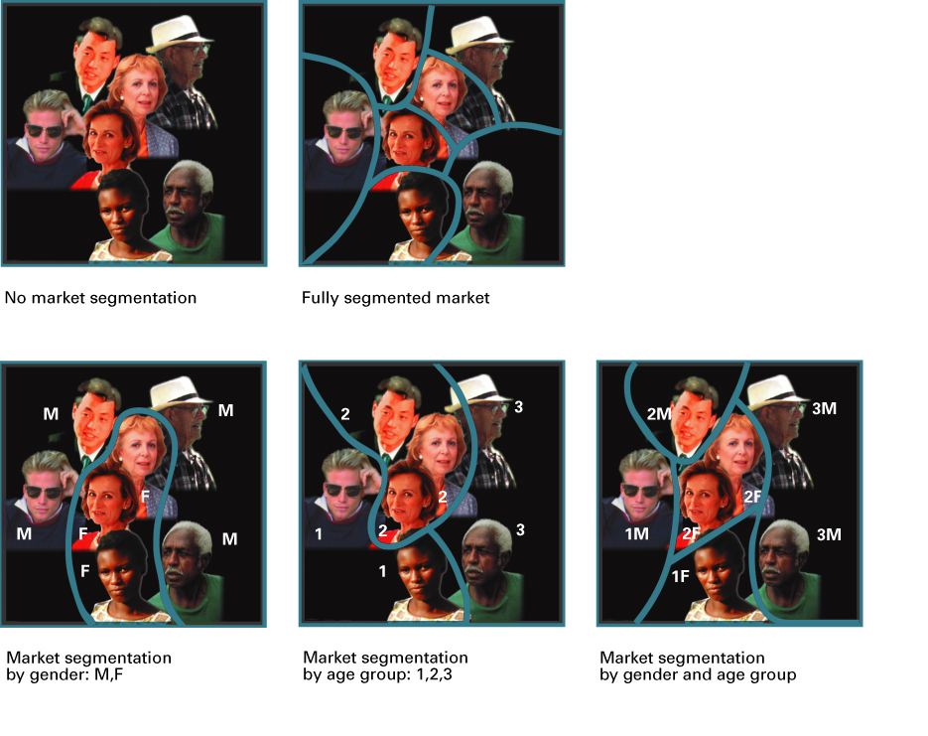
The Concept of Market Segmentation

Slide 5
Reasons for segmentation:
▪ Identification of groups of customers with similar needs, and the analysis of the buying behavior of these groups.
Design of marketing mixes with the characteristics of the segment.
Segmentation helps marketers satisfy customers wants and needs while meeting the organization’s objectives.

Slide 6
Effective Segmentation criteria
Measurable
Size, purchasing power, profiles of segments can be measured.
Segments must be identifiable and their size measurable.
Substantial
Accessible
Segment must be large enough to warrant a special marketing mix.
  Segments can be effectively reached and served.
  Members of targeted segments must be reachable with marketing mix.

Slide 7
Effective Segmentation
Differential
Segment must be respond differently of different marketing mix elements

Slide 8
Segmenting Consumer Markets
Geographic
Bases for
Segmenting
Consumer
Markets
Demographic
age, gender, family life cycle
Psychographic
personality, motives, lifestyles,
Behavioural(occasion, benefit,
User status, usage rate, loyalty status.)

Slide 9
Demographic Segmentation
Demographic information include age, gender, income, ethnic background, and family life cycle.
Today, the average woman gives birth to two children and she usually has her children at a later age—about 35.
  Gender (Male; female),
  Age (Under 6; 6-11; 12-17; 18-24; 25-34; 35-44; 45-54; 55-64; 65-74; 75 and over),
  Life Stage (Infant; preschool; child; youth; collegiate; adult; senior),
  Household Size (1; 2; 3; 4; 5 or more),
  Residence tenure (Own home; rent home),
  Marital Status (Never married; married; separated; divorced; widowed)

Slide 10
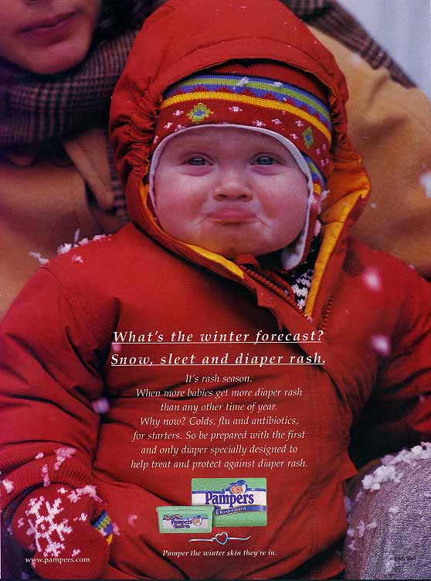
Geographic Segmentation
World Region or Country, City or Metro Size and Density or Climate
When an organization localizes its marketing efforts to accommodate the unique needs of specific geographic regions
Segmenting markets by region of the country or world, market size, market density (number of people within a unit of land), or climate.

Slide 11
Geographic Segmentation
Reasons for a regional approach
  products appealing to local preferences are more likely to be successful
  its easier to react quickly to market changes at regional rather than national level
Dividing overall market into homogeneous groups on the basis of their locations.
Does not ensure that all consumers in a location will make the same buying decision.
Help in identifying some general patterns.

Slide 12
Segmenting by Psychographics
Attitudes, interests, and opinions
Taking this a step further, it is also possible to segment on lifestyle and values. Some consumers want to be seen as similar to others, while a different segment wants to stand apart from the crowd.
Lifestyle segmentation divides people into groups according to how time is spent, the importance of things around them, beliefs, and socioeconomic characteristics such as income and education.

Slide 13
Segmenting by Psychographics
Another basis for segmentation is behavior. Some consumers are “brand loyal”—i.e., they tend to stick with their preferred brands even when a competing one is on sale.
Some consumers are “heavy” users while others are “light” users. For example, research conducted by the wine industry shows that some 80% of the product is consumed by 20% of the consumers—presumably a rather intoxicated (under the influence) group

Slide 14
Behavioral Segmentation
- One can also segment on benefits sought, essentially bypassing demographic explanatory variables.
  Some consumers, for example, like scented soap (a segment likely to be attracted to brands such as Irish Spring), while others prefer the “clean” feeling of unscented soap (the “Ivory” segment).
  Some consumers use toothpaste primarily to promote oral health, while another segment is more interested in breath freshening.
  Our choice should generally depend on several factors

Slide 15
Targeting

Slide 16
Undifferentiated marketing Strategy..
Marketing approach that views the market as one big market with no individual segments and thus requires a single marketing mix.
The first firm in an industry sometimes uses an undifferentiated strategy. Consider Coca-Cola when it had a single product and a single size of its original soft drink.

Slide 17
Undifferentiated marketing Strategy
All consumers are treated as the same, with firms not making any specific efforts to satisfy particular groups. This may work when the product is a standard one where one competitor really can’t offer much that another one can’t. Usually, this is the case only for commodities.
Advantages:
  Potential savings on production and marketing costs
Disadvantages:
  Unimaginative product offerings
  Company more susceptible to competition

Slide 18
Differentiated Marketing…..
A strategy that chooses two or more well-defined market segments and develops a distinct marketing mix for each.
They offer high priced tickets to those who are inflexible in that they cannot tell in advance when they need to fly and find it impractical to stay over a Saturday.
These travelers—usually business travelers—pay high fares but can only fill the planes up partially. The same airlines then sell some of the remaining seats to more price sensitive customers who can buy two weeks in advance and stay over.

Slide 19
Differentiated Marketing
Develops one or more products for each of several customer groups with different product needs
Appropriate when it is possible to identify one or more segments with distinct needs for different types of products, example: L’Oreal (Elseve, L’Oreal, Lancome)
Advantages:
  Greater financial success
Disadvantages:
  High costs
  Cannibalization: Situation that occurs when sales of a new product cut into sales of a firm’s existing products.

Slide 20
Concentrated marketing Strategy
A strategy used to select one segment of a market for targeting marketing efforts.
A concentrated strategy of focusing on a narrow market is sometimes more profitable than spreading resources over several different segments.
A concentrated strategy often enables small firms to compete effectively with much larger firms.

Slide 21
Concentrated marketing Strategy
One firm chooses to focus on one of several segments that exist while leaving other segments to competitors. For example, Southwest Airlines focuses on price sensitive consumers who will forego meals and assigned seating for low prices.
Advantages:
  Concentration of resources
  Meets narrowly defined segment
  Small firms can compete and Strong positioning
Disadvantages:
  Segments too small, or changing
  Large competitors may market to niche segment

Slide 22
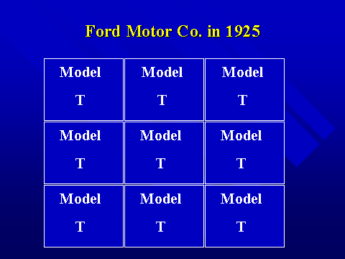
Undifferentiated Targeting Strategy

Slide 23
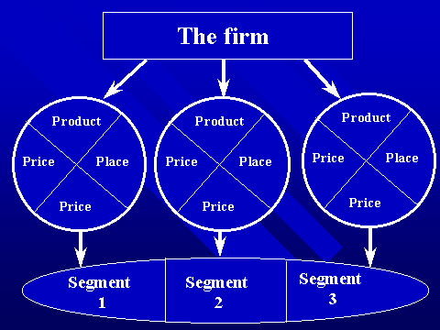
Differentiated/Multi segment
Targeting Strategy

Slide 24
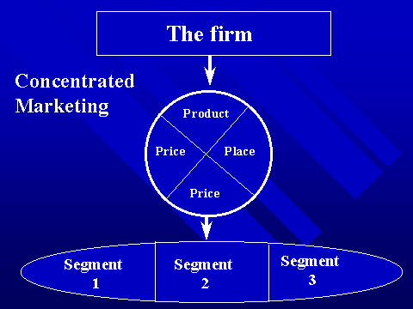
Concentrated Targeting Strategy

Slide 25
Positioning……
Marketing strategy that emphasizes serving a specific market segment by achieving a certain position in buyer’s minds.
Developing a specific marketing mix to influence potential customers’ overall perception of a brand, product line, or organization in general
Positioning is the act of designing the company’s offer and image so that the target understands and appreciates what the company stands for in relation to its competition.

Slide 26
Positioning
Three Elements of Positioning:
  Who you are (Creating an Image)
  How you are different from competition (Differentiation)
  How you can satisfy their needs and wants (Communicating Benefits)
Marketers must:
  Plan positions to give their products the greatest advantage in selected target markets,
  Design marketing mixes to create these planned positions.

Slide 27
Select Positioning Strategy…
Positioning is the image that customers have about a product, especially in relation to the product’s competitors.
Ways to Position: Price/Quality, Product Attributes, Product User, Product Usage, Product Class, Competition, Symbol
Perceptual mapping is graphically depicting a product’s performance on selected attributes or the “position” of a product against its competitors on selected product traits..

Slide 28
Select Positioning Strategy
PM is a research tool that can be used to measure a brand’s position.
Multidimensional Scaling (MDS) is one specific technique that can be used
Identify the brand’s competitive set
Show brand position relative to certain criteria and to specific organizations in the competitive set

Slide 29
Perceptual Map
High Quality
A
G
D
E
C
B
Low
Price
High
Price
F
Low Quality

Slide 30
Repositioning
It involves an attempt to change consumer perceptions of a brand, usually because the existing position that the brand holds has become less attractive.
Sears, for example, attempted to reposition itself from a place that offered great sales but unattractive prices the rest of the time to a store that consistently offered “everyday low prices.”

Slide 31
Repositioning..
Repositioning in practice is very difficult to accomplish.
A great deal of money is often needed for advertising and other promotional efforts, and in many cases, the repositioning fails.

Slide 32
Identifying Possible Competitive Advantages
Key to winning and keeping customers is to understand their needs and buying processes better than competitors do and deliver more value.
Competitive advantage is an advantage over competitors gained by offering consumers greater value, either through lower prices or by providing more benefits, that justify competitive advantage.

Slide 33
Identifying Possible Competitive Advantages
Product
Differentiation
i.e. Features, Performance, Style & Design, or Attributes
Services
Differentiation
i.e. Delivery, Installation,
Repair, Customer
Training
i.e. Symbols, Atmospheres, Events
Personnel
Differentiation
i.e. Hiring, Training Better People Than Competitors Do

